Slide 1
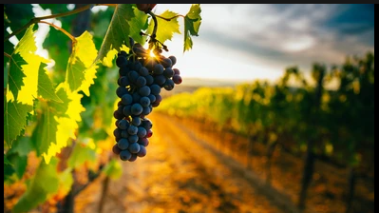
Bacchus Winery
Ricardo Orlando, Monica Jones, Donnell Perkins

Slide 2

Group Introduction
Ricardo Orlando
Warehouse Supervisor
Favorite Wine: Mascato or Chardonnay
Monica Jones
QE Manager
Favorite Wine: Merlot or Malbec
Donnell Perkins
Software Programmer
Favorite Wine: Red Blend

Slide 3
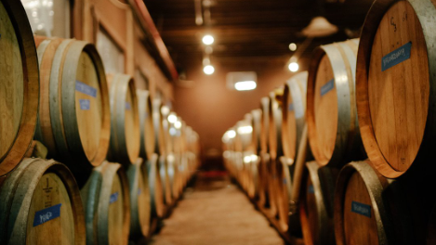
Stan and Davis Bacchus inherited their winery from their Father, George, three years ago upon his retirement.
When they started running the winery, the owners decided to keep all existing personnel in place, hoping to effect minimum change during the turnover.
Bacchus winery grows the grapes needed to make a Merlot, Cabernet, Chablis, and a Chardonnay.
Stan and Davis would like to find a more efficient method of keeping track and ordering supplies, perhaps over the internet.
Maria, who is responsible for distribution, would like their distributors to be able to order online, and to be able to track shipment.

Slide 4
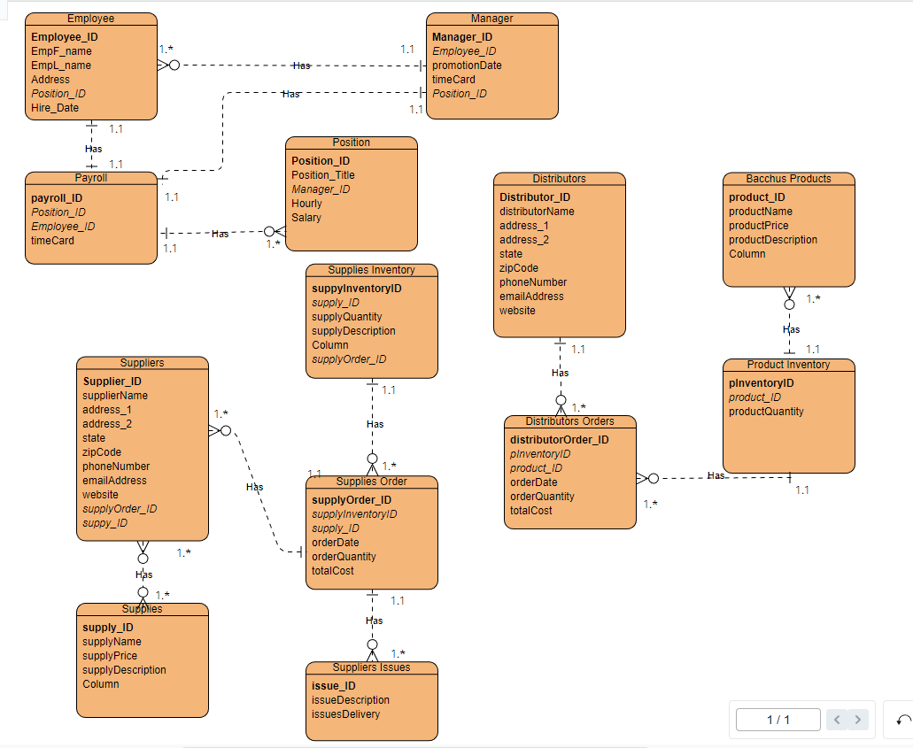
Finalized ERD

Slide 5
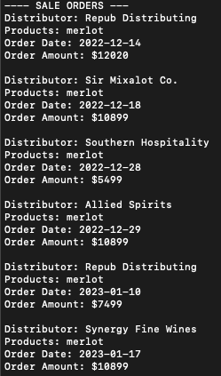
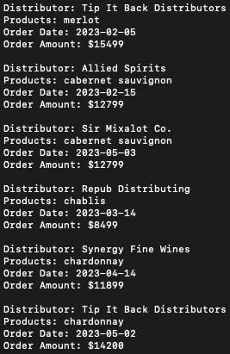
Product Sales Report
This report with show the total number of orders for all product sales. They would be used to see the total volume of sales of the company.

Slide 6
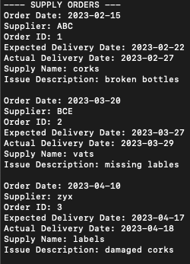
Delivery and Issues Report
This report will show the expected vs the actual delivery dates and the issues with supply orders.

Slide 7
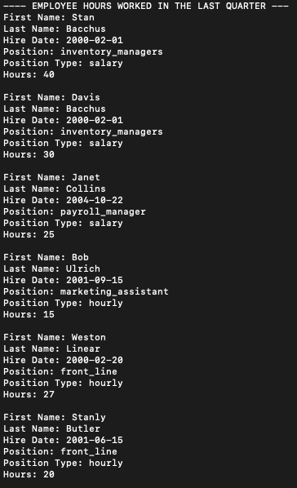
Employee Time Keeping Report
This report will include the employee's name, position, position type, and hours. This provides an answer to how many hours an employee has worked.

Slide 8
Bacchus has contracted suppliers. ​
Bacchus has several employees.
Bacchus has monthly orders.
Bacchus has monthly inventory.

Slide 9
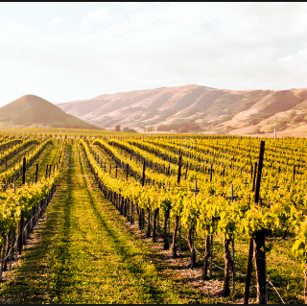
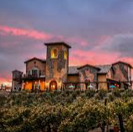
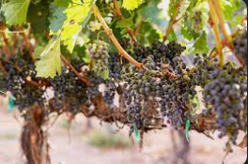
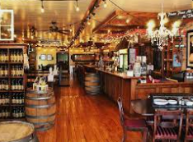
Thank you
Ricardo Orlando, Monica Jones, Donnell Perkins

